Slide 1
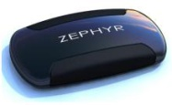
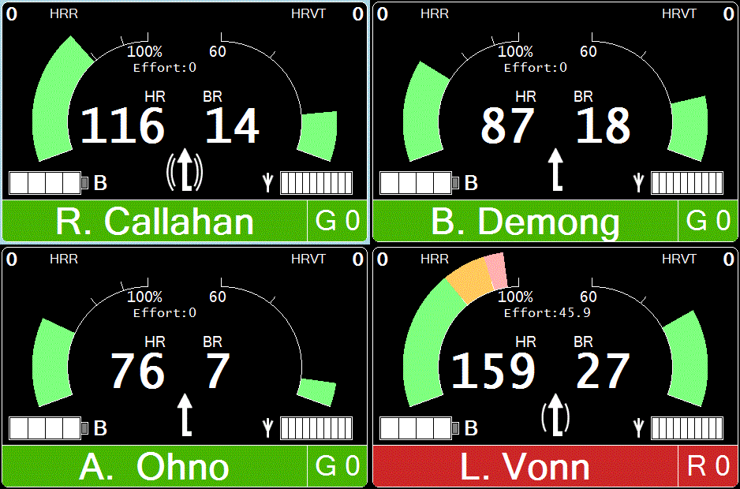
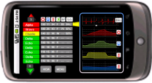
Zephyr Measure Life . . . Anywhere
WPI Body Area Network Conference
"Practicality of BAN for Physiological Monitoring and Various Applications"
June 20 2011, Worcester, Presenter: Brian Russell
Notes:
What is it
It works
it solves a problem – people want it.
Platform – applicable in different verticals
Scaling in 2010 via channel partners
Defendable IP and operational knowledge

Slide 2
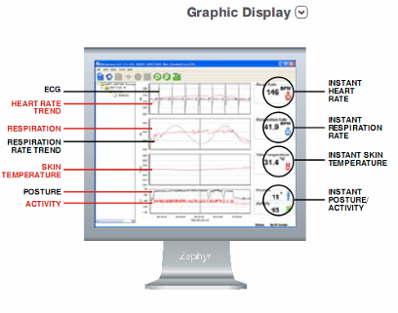
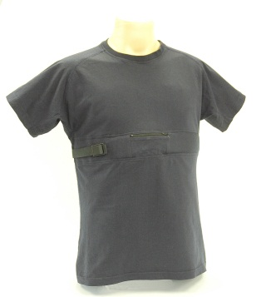
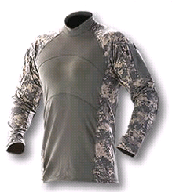
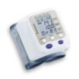
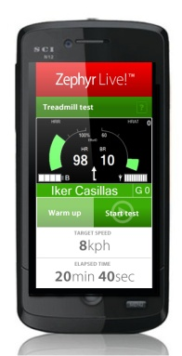
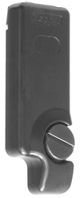
BioHarness™ - BlueTooth BAN
Biometric Monitors
ECG, Heart rate,
Breathing Rate,
Skin temperature,
Activity
Posture
Built in BioSense® analysis algorithms
Logging for 20 days
Local wireless (Bluetooth)
Wired (optical) - defense
Blood Oxygen
BioModule
Prototype
Blood Pressure
Shirt
BioHarness
Radio interface device
to voice radio
Mobile feedback

Slide 3
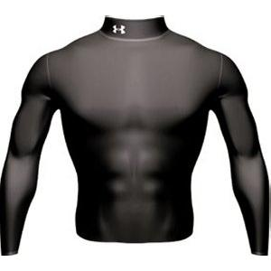
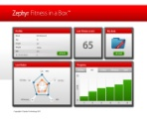
BAN to Internet
Connects to other Apps – e.g. DISPATCH
Zephyr’s API will allow channel partners to
Zephyr Vault
The web portal securely stores all Published data from remote sensors.
From here mobile phones and personal computers can access the information transmitted by the devices
in real time
Personal Data
User transmitting personal bio-statistics through a Zephyr BioHarness
Radio Device
Person uses radio/phone to
connect to the cloud
BioHarness
Web Portal
Performance is viewed and analyzed in the cloud.
Blood Glucose
Blood Oxygen
Weigh Scale
Blood Pressure
BAN connects system to the cloud
Data is valuable when viewed some where else

Slide 4
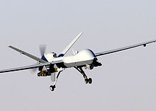
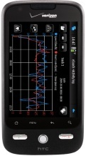
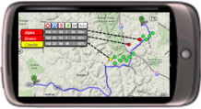
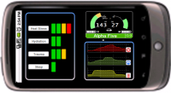
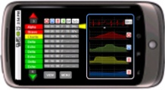
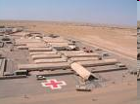
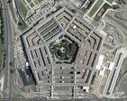
BAN Tactical Communications
C2 = Command and Control
TCCC = Tactical Combat Casualty Care
Command and Control
Tactical
Net
Group Medical Summary
Sat / Tactical Radio or
Cellular
Satellite
Cellular
Tactical Radio
UWB / Bluetooth
MEDEVAC
Local Commander
Soldier
Squad
Commander
FOB
Field Hospital
HQ
Medic
100 ft 2 to 10 miles over the horizon
Notes:
4

Slide 5
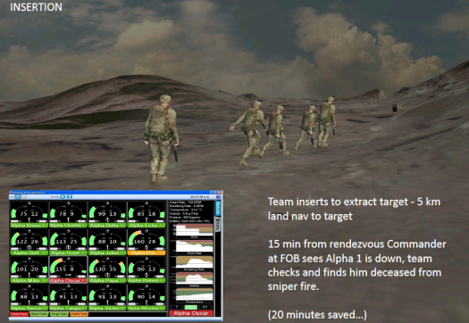
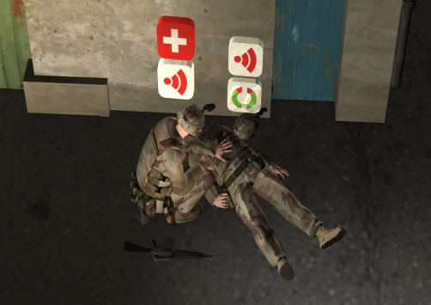
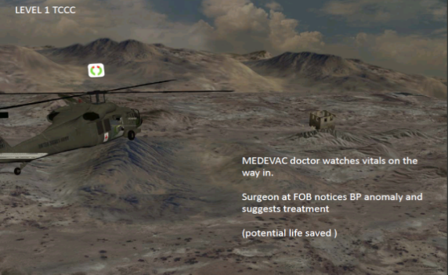
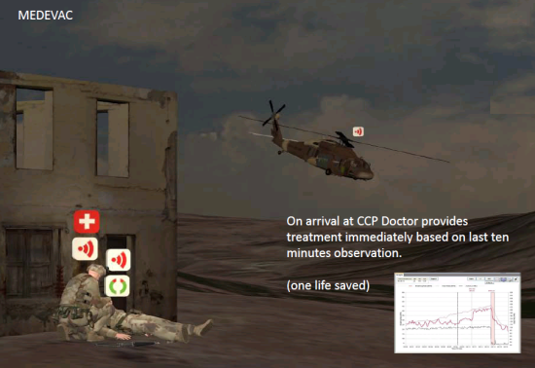
BAN should support concept of operation
6
1
Squad quick ropes from helicopter
Sniper goes to high ground
Attack group assembles behind ground cover
Sniper is ambushed and injured. He uses his personnel PSM display to treat himself. Squad commander sees the injury on his device and changes tactics assuming no over site from fire control. Medic uses his PSM display determines Sniper is dealing with bleeding and is not in shock so stays with attack team.
Attack team splits and enters building.
Attack team has casualty, medic sees this on his display and attends casualty.
Medic takes casualty to CCP, casualty collection point.
COC, command and control at FOB, Forward Op Base, sees causalities on their display and immediately deploys QRF, Quick Reaction Force.
MEDEVAC sees vitals on their PSM display, gives advice and treats immediately.
!
2
3
5
!
4
7
+
4
3
2
5
6
7
1
8
8
9

Slide 6
PSM use examples in First Responder
ON SCENE
UPDSIDE DOWN = BAD always
STATIONARY = BAD for a Fire Fighter
HEART RATE RECOVERY= indicates fatigue, uses combination of HR and Acceleration.
REHAB
Automate vital sign monitoring. HRrest, BRrest, BP, SpO2
Reduce EMS workload, trending offers more insight than occasional data.
FITNESS
Increased fitness = less risk of heart attack and increased situational awareness. Europe has a VO2max > 45 ml/min/kg
TRAINING
Remote vital signs to monitor performance for job related training.
Normal levels indicates safety and continuation is acceptable.

Slide 7
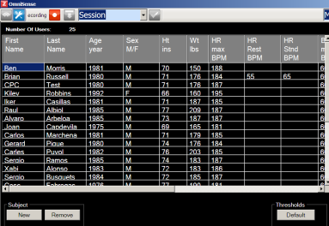
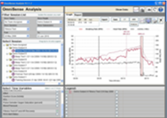
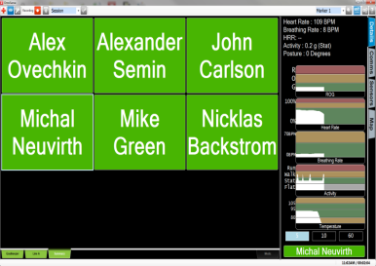
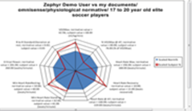
Usage Philosophy
Enter personnel into database
Baseline physiology
Monitor live
Reports
(change conops based on historical data)

Slide 8
Value Analysis of new technology
Incremental value = sum of increased function or decreased hassle associated with innovation type.
Reference value = what customers use as the next best alternative
A product in general should excel in at least 6 areas of innovation to have good chance of success.
Incremental Function Value
Reference Function Value

Slide 9
New Technology – value analysis
PERSONAL
PERFORMANCE
WORK FLOW
ORGANISATION
1
4
7
10
FASHION COMFORT
Only unnoticeable tech
Will be adopted.
No one wants to look
silly.
RADIO RANGE
Under all realistic
obstacles and interferes
DEPLOYMENT
At base, going to on
scene, during the mission,
maintenance
SITUATIONAL AWARENESS
Allows prediction future mission success. Increased safety. Personal and to commanders
2
5
8
11
ENTANGLEMENT RISK
Tech should not encumber or snag.
BATTERY LIFE
Operational ease of use.
Multi mission capability.
Minimum spares.
Easily purchased in the
field.
Battery life time vs cycles.
TRAINING LOAD
Easy to use and
remember how to use. Applies to wearer and the
support /command team.
Uses standard measures
COST SAVINGS
Can be from increased mission efficiency, decreased injuries or less overall equipment
3
6
9
12
DONNING DOFFING
Ease of use is
imperative
SIZE WEIGHT
Always a minimum.
Extra weight removes
Other equipment or
Increases fatigue.
EQUIPMENT INTEGRATION
Radio, computers,
displays, computers,
uniform
STANDARDS
Susceptibility to jamming,
Detectability by others,
Environmental loads
NFPA, FCC, Intrinsic safety, CE,
FDA, HIPAA …

Slide 10
Value Analysis Examples
COLD: Custom short range ISM radio
good for situational awareness, interference issues, not enough range for operational use, not a standard interface
to other systems.
WARM: Bluetooth connected shirts to APCO Radios
good for situational awareness, integrated into uniform, Bluetooth good for displays, requires Motorola radios
HOT: Cellular connected shirts
Secure cellular in uniform. Zero deployment hassle and always connected to internet. Still needs BAN for displays

Slide 11
Thank you

Slide 12
Tracking and Managing Player Fatigue
This plot shows Heart Rate Percentage and Heart Rate Recovery trends over time through an entire hockey game. The downward trend in Heart Rate Recovery correlates to the fatigue of the player resulting in a decrease in sharpness and performance as well as a decrease in aggressiveness of play. HRR can be tracked in live mode based on our algorithms which automatically detect and display the data in the player’s bioguage. Knowing what level is too low for a player is key to knowing how ready they are to perform at their optimal level of performance.

Slide 13
Tracking/Detecting Impact on Players
Continuous measurement of impact, track how much abuse players are enduring game to game. This image shows a 14g impact when one player was slammed into the boards.

